Slide 1



DEEP LEARNING
FOR CLASSIFICATION OF TUBERCULOSIS - RELATED CHEST X-RAY
PRESENTED BY
HARSHIT RANJAN (BT22CSA029)
SHARIT VAISHNAV(BT22CSA042)
PRAJWAL PRASAD(BT22CSA043)
HARSH SUHAN(BT22CSA034)

Slide 2

1 | INTRODUCTION
2 | PROBLEM STATEMENT
3 | LITERATURE REVIEW
4 | MOTIVATION
5 | OBJECTIVE OF WORK
6 | Methodology
7 | Results
CONTENTS
8
CONCLUSION OF FUTURE WORK
9
REFERENCES

Slide 3
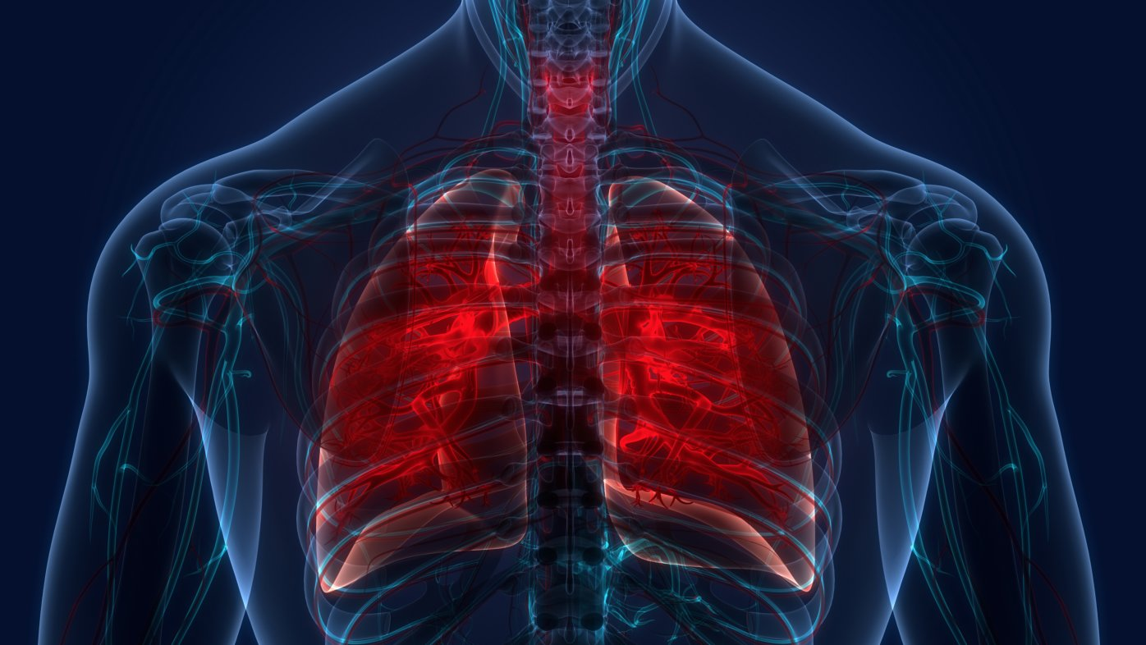
INTRODUCTION
Tuberculosis (TB) drug resistance presents a global health crisis, challenging treatment efficacy and exacerbating disease transmission. Early detection of drug-resistant TB is critical, yet treatment success rates remain modest. Machine learning (ML) algorithms offer promising solutions by efficiently analyzing diverse data sources, including radiological and genomic features, to enhance TB drug susceptibility assessment and treatment outcome prediction. ML's capacity to uncover intricate patterns and inform tailored interventions holds transformative potential for healthcare. By harnessing ML, clinicians gain streamlined tools for timely diagnosis and personalized treatment, fostering a future where TB drug resistance is effectively managed, benefiting global health endeavors.
03

Slide 4

PROBLEM STATEMENT
The escalating challenge of treating tuberculosis (TB) is compounded by the emergence of drug-resistant strains, making the disease increasingly formidable to manage. Timely detection of drug-resistant TB holds paramount importance in both patient care and curtailing the spread of the disease. To develop and validate a machine learning model that accurately predicts the likelihood of Tuberclosis in individuals by analyzing and processing symptomatic data of chest x-rays. This model aims to assist healthcare providers in early detection and timely intervention, thereby reducing the spread of the virus and facilitating appropriate medical responses. The overarching goal is to enhance public health response capabilities through the application of advanced data-driven technologies.
04

Slide 5
LITERATURE REVIEW
AUTHOR | ACURACY | PARAMETER USED
BUI & YANIV 2023 | 91.4% | Precision, Recall, Accuracy, F1 Score
HENDRICK HENDRIK 2021 | 94.8 | Identification of driver mutations, distinguishing them from neutral ones
RAHMAT HEDAYAT, 2021 | 91.8 | Quality of variant prioritization in driver mutation prediction pipelines
ZHI HAO WANG, 2021 | 98.1 | Quality of variant prioritization in driver mutation prediction pipelines
MICHAEL HARRIS, 2023 | 94.2 | Genomic mutations analysis for personalized treatment strategies
06

Slide 6
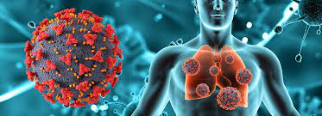
Motivations
1. Global Health Impact: Tuberculosis (TB) remains a significant global health threat, particularly with the emergence of drug-resistant strains. Motivated by the urgent need to address this pressing issue, there is a growing impetus to develop innovative approaches for early detection and effective management of drug-resistant TB.
2. Treatment Challenges: The treatment of drug-resistant TB poses significant challenges due to lower treatment success rates compared to drug-sensitive TB. Addressing these challenges requires a deeper understanding of TB pathogenesis, drug susceptibility, and treatment outcomes, motivating research efforts to explore novel methodologies.
3. Data Availability: The TB Portals program offers a unique opportunity to access a comprehensive dataset encompassing diverse information such as radiological images, genomic sequences, and clinical data from TB patients worldwide. The availability of such rich data sources motivates researchers to explore advanced analytical techniques to extract meaningful insights and improve TB management strategies.
05

Slide 7
OBJECTIVE
Our primary aim is to explore the synergies between radiological features extracted from chest X-rays in enhancing the identification of drug susceptibility types and predicting the presence of the disease in a human body.
Through a series of rigorous evaluation studies, we demonstrate the efficacy of integrating radiological and genomic features in refining predictive models for detection outcomes.
05

Slide 8
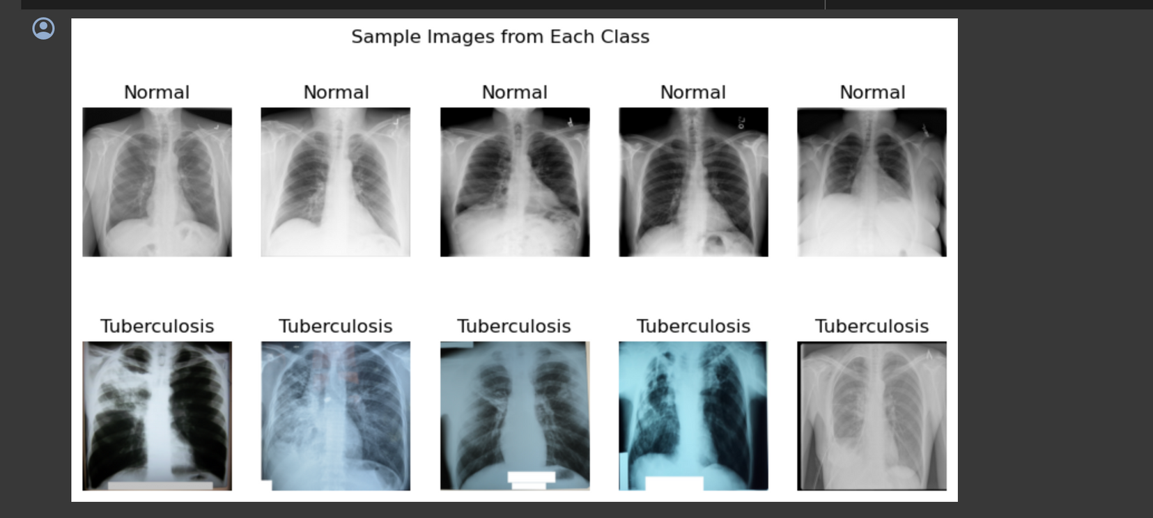
DATA DESCRIPTION
Back to Agenda
A team of researchers from Qatar University, Doha, Qatar, and the University of Dhaka, Bangladesh along with their collaborators from Malaysia in collaboration with medical doctors from Hamad Medical Corporation and Bangladesh have created a database of chest X-ray images for Tuberculosis (TB) positive cases along with Normal images. In our current release, there are 700 TB images publicly accessible and 2800 TB images can be downloaded from NIAID TB portal[3] by signing an agreement, and 3500 normal images.
07

Slide 9
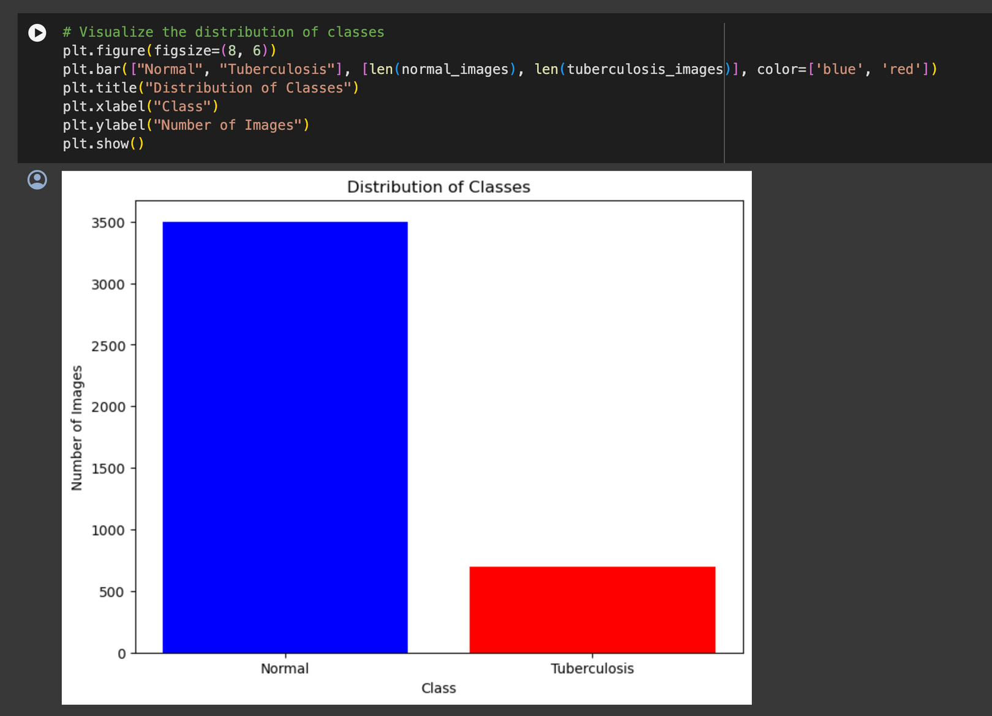
DATA UNDERSTANDING
NCBI(National Center for Biotechnology) datasets and the National Library of Medicine (NLM) X-ray set were included in this study. The dataset collected 3500 normal and 700 abnormal CXR showing various manifestations of TB in PNG format.
07

Slide 10
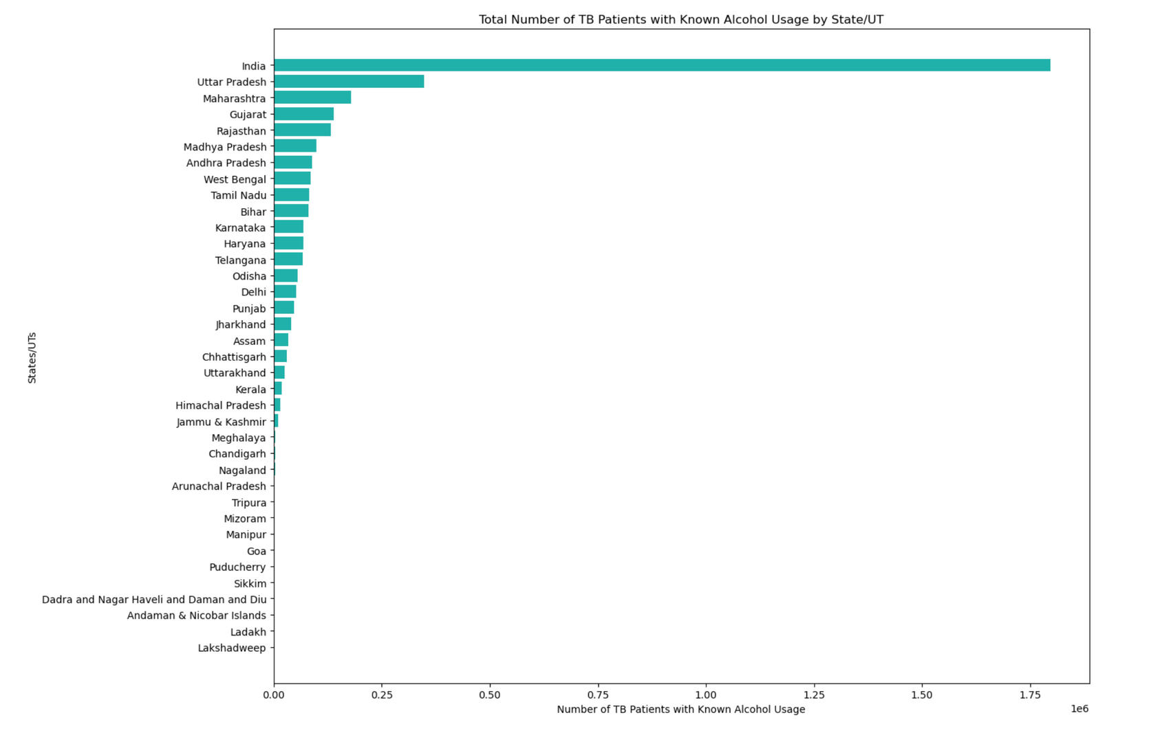
DATA VISUALIZATION
08

Slide 11
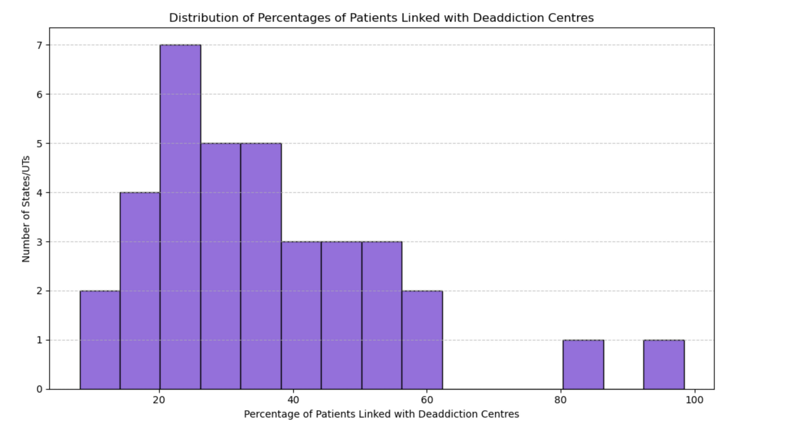
DATA VISUALIZATION
08

Slide 12
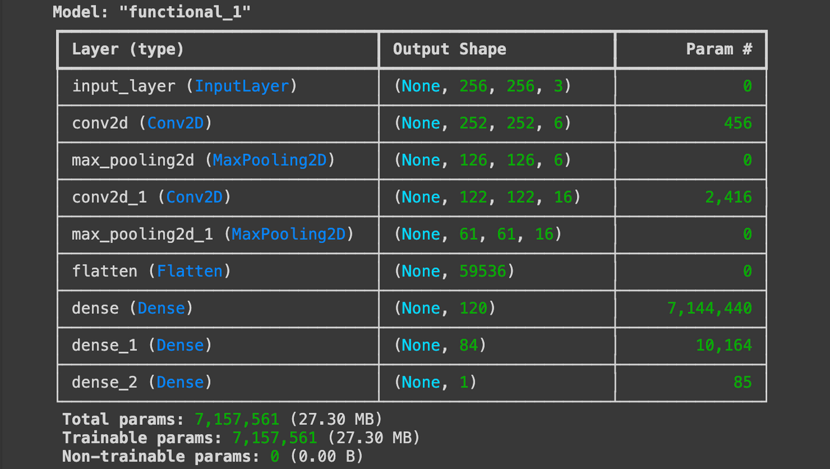
MODEL FORMATION
1. Function Definition (create_lenet_model) :
This function defines the architecture of the LeNet model.
It takes two parameters:
Input_shape: The shape of the input images. For example, (256, 256, 3) indicates images with a height and width of 256 pixels and 3 channels (RGB).
num_classes: The number of classes in the classification task. Default is set to 1, which suggests binary classification.
2. Input Layer:
inputs = layers.Input(shape=input_shape): This line defines the input layer of the model with the specified input shape.

Slide 13
3. Convolutional Layers:
x = layers.Conv2D(6, (5, 5), activation='relu')(inputs): This line creates the first convolutional layer with 6 filters/kernels of size 5x5 and ReLU activation function.
x = layers.MaxPooling2D((2, 2))(x): This line adds a max-pooling layer with a pool size of 2x2 after the first convolutional layer.
x = layers.Conv2D(16, (5, 5), activation='relu')(x): This line adds a second convolutional layer with 16 filters/kernels of size 5x5 and ReLU activation function.
x = layers.MaxPooling2D((2, 2))(x): This line adds another max-pooling layer after the second convolutional layer.
4. Flattening and Fully Connected Layers:
x = layers.Flatten()(x): This line flattens the output from the convolutional layers into a 1D array.
x = layers.Dense(120, activation='relu')(x): This line adds a fully connected layer with 120 neurons and ReLU activation function.
x = layers.Dense(84, activation='relu')(x): This line adds another fully connected layer with 84 neurons and ReLU activation function.
5. Output Layer:
outputs = layers.Dense(num_classes, activation='sigmoid')(x): This line adds the output layer with a number of neurons equal to the number of classes specified in num_classes. The activation function used here is the sigmoid function, which is common for binary classification tasks.
6. Model Compilation and Return:
model = Model(inputs=inputs, outputs=outputs): This line creates a Keras Model object with the defined input and output layers.
Finally, the function returns the created model.

Slide 14



BLOCK DIAGRAM

Slide 15
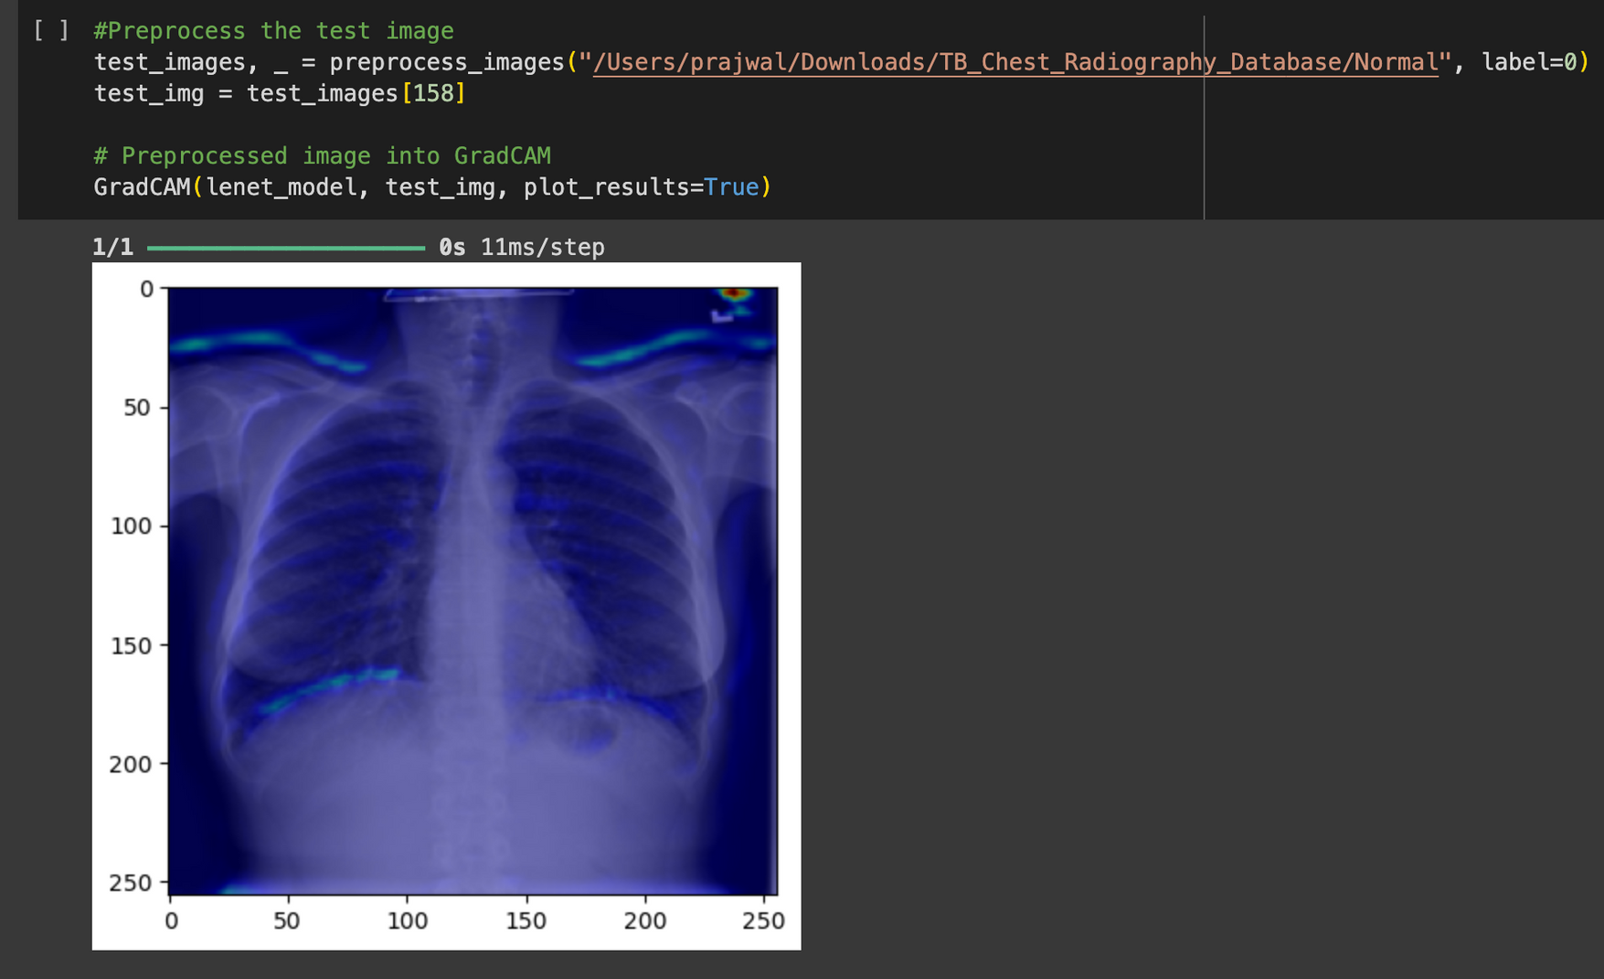
RESULT:
GRADCAM
08

Slide 16
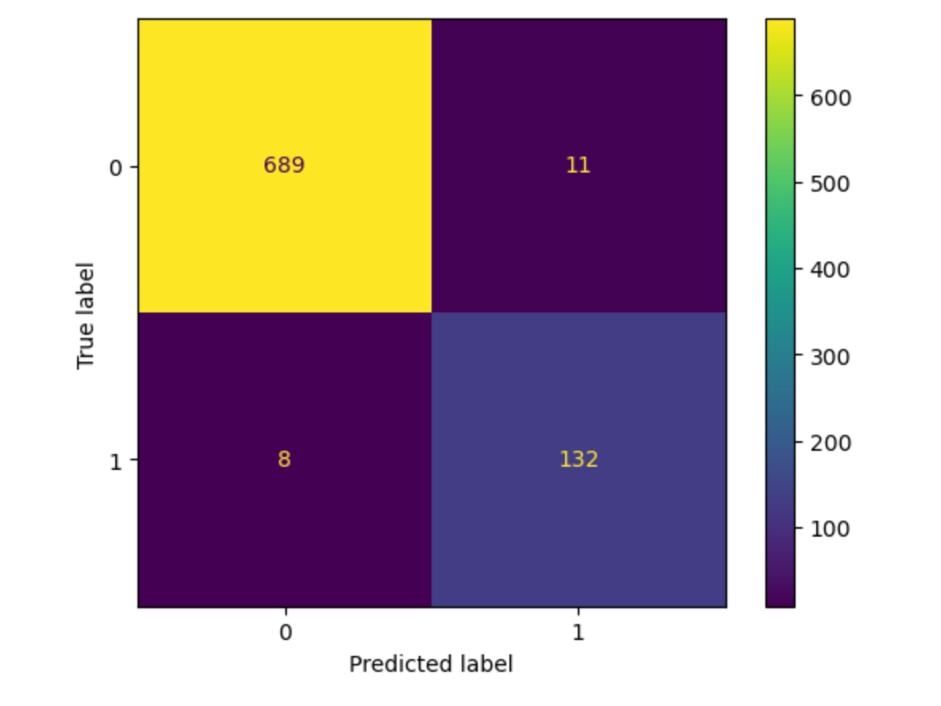
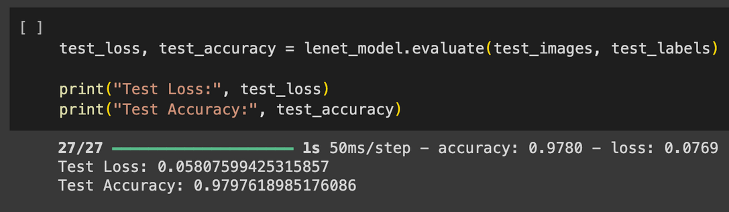
RESULT :
CONFUSION MATRIX
08

Slide 17
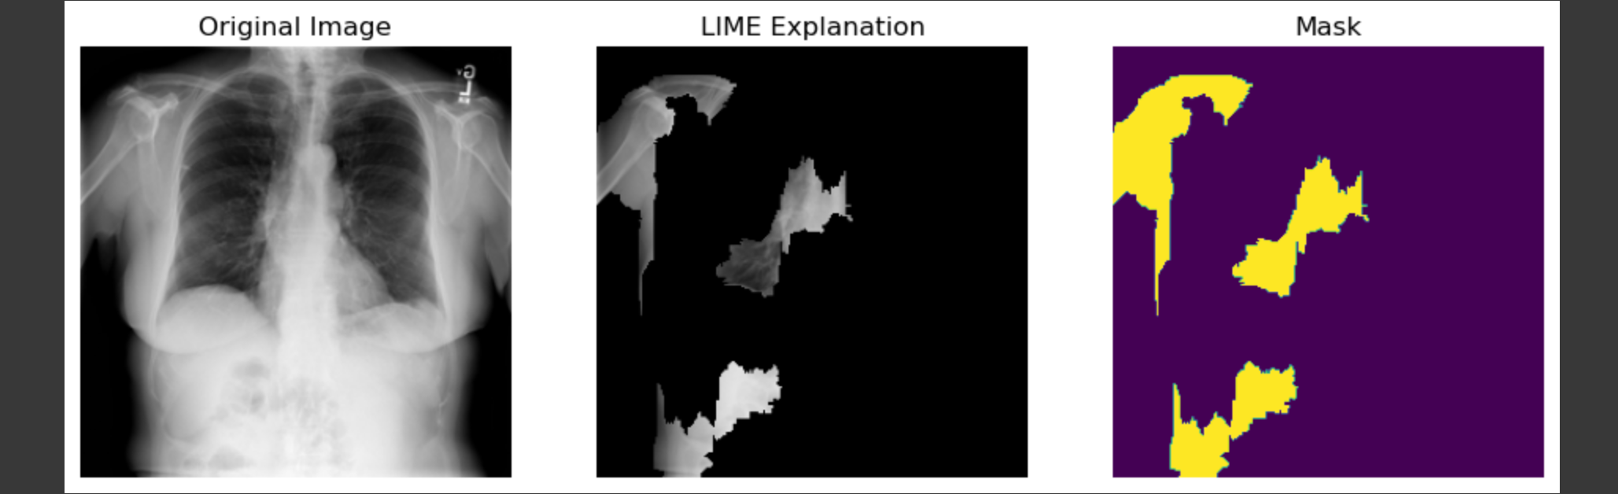
08

Slide 18
CONCLUSION
In this study, we explored the potential of machine learning algorithms for tuberculosis detection using Chest X-Ray datset from NLM. Our results demonstrate promising accuracy rates (97.9%) in distinguishing TB cases from healthy individuals or other respiratory conditions.
FUTURE WORKS:-
Integration of multimodal data: Explore the incorporation of additional data modalities such as radiographic images, genetic markers, or clinical metadata to improve model performance and provide comprehensive diagnostic insights.
Transfer learning and domain adaptation: Investigate the applicability of transfer learning techniques to adapt pre-trained models to different populations or healthcare settings, thereby enhancing model generalization and scalability.
Real-time deployment: Develop real-time diagnostic systems capable of providing immediate feedback to healthcare providers, enabling timely intervention and treatment initiation.

Slide 19


1. World Health Organization. Chest radiography in tuberculosis detection: Summary of current WHO recommendations and guidance on programmatic approaches. Geneva: World Health Organization; 2016.
2. Wiens J, Shenoy ES. Machine Learning for Healthcare: On the Verge of a Major Shift in Healthcare Epidemiology. Clin Infect Dis. 2018;66(1):149-53. doi:10.1093/cid/cix731.
3. Wang X, Peng Y, Lu L, Lu Z, Bagheri M, Summers RM. ChestX-ray8: Hospital-scale Chest X-ray Database and Benchmarks on Weakly-Supervised Classification and Localization of Common Thorax Diseases.arXiv:170502315. 2017.
REFERENCES
4. Rajpurkar P, Irvin J, Zhu K, Yang B, Mehta H, Duan T et al. CheXNet: Radiologist-Level Pneumonia Detection on Chest X-Rays with Deep Learning. arXiv:171105225. 2017.
5. Yao L, Poblenz E, Dagunts D, Covington B, Devon Bernard KL. Learning to diagnose from scratch by exploiting dependencies among labels. arXiv:171010501. 2017.
6. Maduskar P, Hogeweg L, Ayles H, van Ginneken B. Performance evaluation of automatic chest radiograph reading for detection of tuberculosis (TB): a comparative study with a clinical officers and certified readers on TB suspects in sub-Saharan Africa. Insights Imaging. 2013;4(Suppl1):S322.

Slide 20


